Slide 1
- Presented by:
Mrinal Aich
(cs16mtech11009)
SIMPLE-fying middlebox traffic steering
policy enforcement

Slide 2
Significance of the paper
Logically implement Middlebox routing policy
by translating forwarding rules.

Slide 3
Scope of SDN in
Middlebox policy enforcement
1. Composition
Manually placement of the middleboxes
based on requirement

Slide 4
2. Load Balancing
Avoid the need for operators to
(1) manually install traffic steering rules
(e.g. EmployeeGroup & GuestGroup)
(2) load balancing rules.
Suppose:
Big Network having 50 Firewalls and 50 IDSes
Limitation:
No. of forwarding rules are limited in TCAM of SDN switches
TCAM:Temporary Cache Addressable Memory

Slide 5
3. Dynamic Packet Transformation
Modify packet headers and session level behaviours
e.g. Implementing NAT
Limitation: Propietary nature of middleboxes,
contoller may have limited functionality.

Slide 6
Assumptions in the paper
1. within existing SDN capabilities (L2/L3)
2. no Middlebox modification

Slide 7
Scenario 1: based on input-ports and NO loops
Policy Chain : {FW – Proxy - IDS}

Slide 8
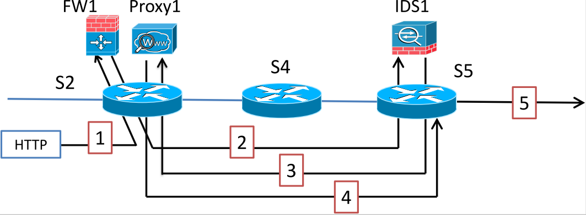
Scenario 2: Looping
Policy Chain : {FW1 – IDS1- Proxy1}

Slide 9
Approach
1. Tunnels between Switches
2. Packet modification : 'Tags / ProcState'
To encode packet processing state
(form of : VLAN tags, MPLS labels)

Slide 10
Rules at S2:
{HTTP, from FW1} -> ProcState =FW
{HTTP, from Proxy1} -> ProcState =Proxy
Rules at S5:
{HTTP, ProcState =FW} ->forward to IDS1
{HTTP, from IDS1} -> ProcState = IDS1
{HTTP, ProcState =Proxy} -> forward to destination
Idea: S5 uses ProcState tags to differentiate between the ﬁrst instance of the packet arriving in the second segment (send to IDS) and the fourth segment (send to destination).

Slide 11
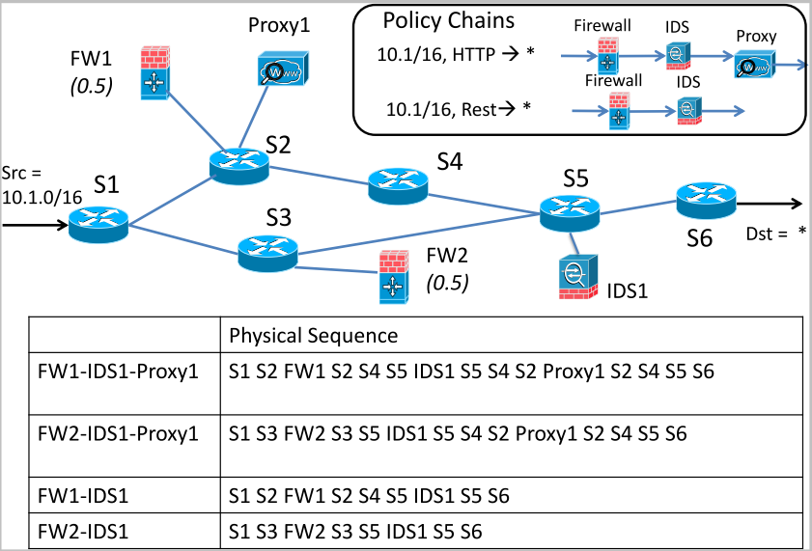
Actual problem ???

Slide 12
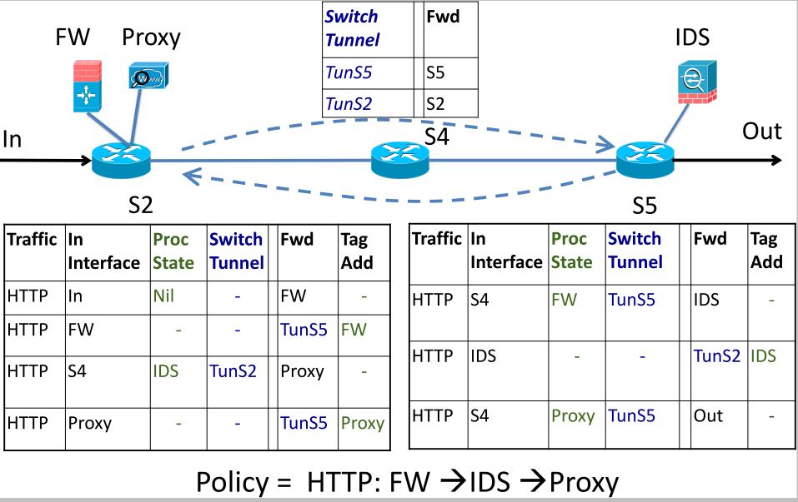

Slide 13
Implementation
Points considered:
SDN-ization portion of the paper.
a. Modification OpenFlow packets to include 'Tag/ProcState' information.
b. Adding rules based on 'ProcState' and 'TunnelSwitches'.
c. Work on static network topology only.
Points not considered:
Paper specific - System module portion of the paper
a. Dynamic Handler – maps the incoming packet headers/session related info.
b. Resource Manager – takes into account the switch and middlebox constraints
c. Rule Generator – generates routing rules to forward traffic.

Slide 14
Thank You

